Slide 1
Credit Card fraud Detection
-Akarsh Tyagi

Slide 2
Agenda
Understanding the problem statement.
Understanding the Data
Steps Involved
Key insights
Results
Testing on Imbalance data
Top 10 variables
Cost benefit Analysis

Slide 3
Understanding the problem statement
For many banks, retaining high profitable customers is the number one business goal. Banking fraud, however, poses a significant threat to this goal for different banks. In terms of substantial financial losses, trust and credibility, this is a concerning issue to both banks and customers alike.
It has been estimated by Nilson report that by 2020 the banking frauds would account to $30 billion worldwide. With the rise in digital payment channels, the number of fraudulent transactions is also increasing with new and different ways.
In the banking industry, credit card fraud detection using machine learning is not just a trend but a necessity for them to put proactive monitoring and fraud prevention mechanisms in place. Machine learning is helping these institutions to reduce time-consuming manual reviews, costly chargebacks and fees, and denials of legitimate transactions.
In this project, I analysed customer-level data which has been collected and analysed during a research collaboration of Worldline and the Machine Learning Group.

Slide 4
Understanding the Dataset
index - Unique Identifier for each row
transdatetrans_time - Transaction DateTime
cc_num - Credit Card Number of Customer
merchant - Merchant Name
category - Category of Merchant
amt - Amount of Transaction
first - First Name of Credit Card Holder
last - Last Name of Credit Card Holder
gender - Gender of Credit Card Holder
street - Street Address of Credit Card Holder
city - City of Credit Card Holder
state - State of Credit Card Holder
zip - Zip of Credit Card Holder o
lat - Latitude Location of Credit Card Holder
long - Longitude Location of Credit Card Holder
city_pop - Credit Card Holder's City Population o
job - Job of Credit Card Holder
dob - Date of Birth of Credit Card Holder
trans_num - Transaction Number
unix_time - UNIX Time of transaction
merch_lat - Latitude Location of Merchant
merch_long - Longitude Location of Merchant
is_fraud - Fraud Flag <--- Target Class

Slide 5
Steps taken
Step 1: Reading and Understanding the Data
Step 2: Data Cleansing
Null Check
Data type check
Step 3: Data Visualization
Imbalanced Data check
Data Distribution Plots
Step 4: Splitting the Data into Training and Testing Sets
Stratified Train Test Split
Skewness Check and Fix
Step 5: Building a Logistic Model
Logistic Regression on Balanced Data (Random Over Sampling,SMOTE,ADASYN)
Decision Tree Model on Balanced Data
Random Forest on Balanced Data (Random Over Sampling,SMOTE,ADASYN)
Stratified K-Fold and Hyperparameter Tuning
Classification Report
Confusion Matrix
ROC AUC Curve
Step 6: Final Analysis
Best Model Selection
Features Importance

Slide 6
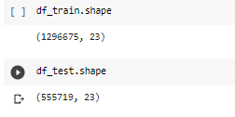
Key Insights
Checking the shape of the dataset.

Slide 7
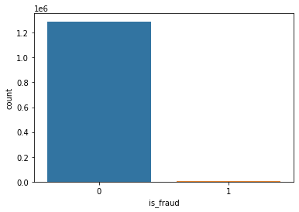
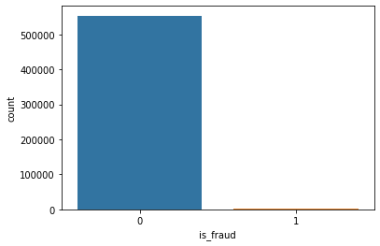
Imbalance Data check
For train and test sets
As we see here a case data imbalance

Slide 8
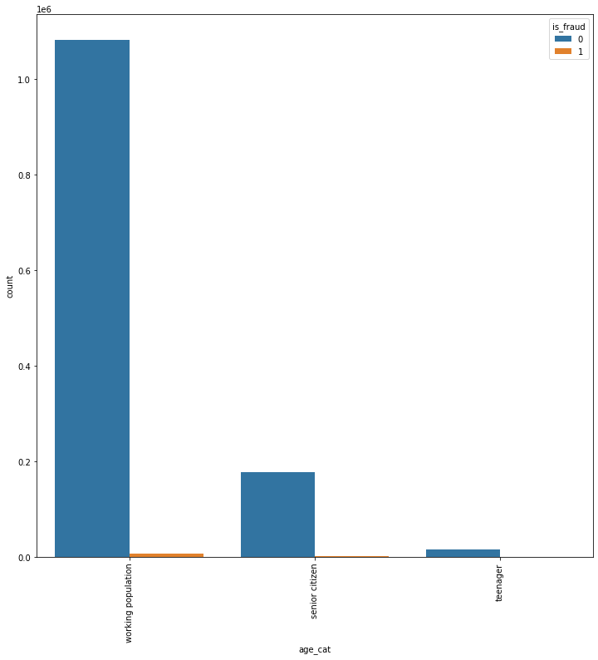
Distribution of the data along age category

Slide 9
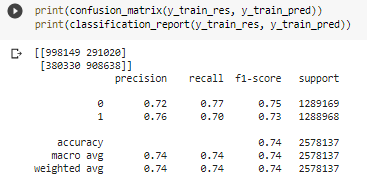
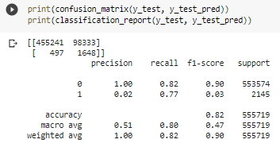
Results for Logistic regression model
Confusion matrix for train set and test set

Slide 10
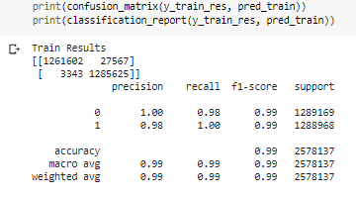
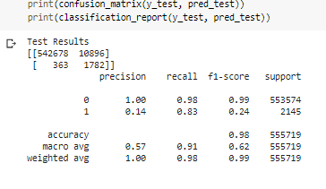
Confusion matrix for decision tree model
For train and test set

Slide 11
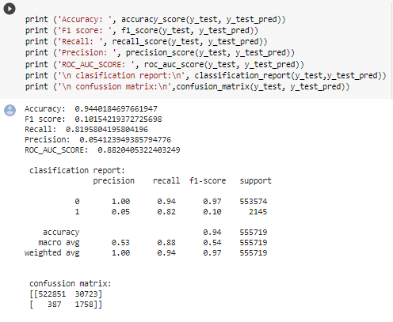
Confusion matrix for random forest model

Slide 12
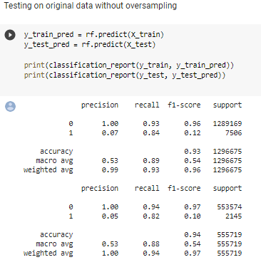
Testing on imbalanced data

Slide 13
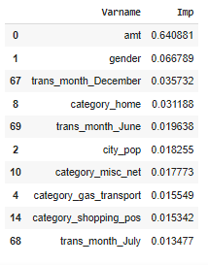
Top 10 features

Slide 14
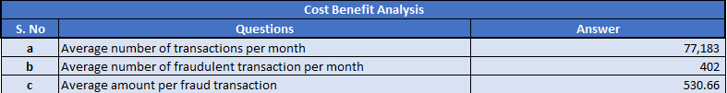
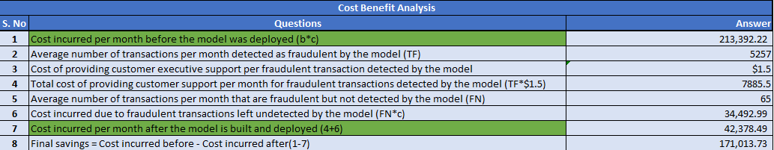
Cost Benefit Analysis

Slide 15
After New Model Deployment
5257 fraudulent transactions detected by the model
$ 1.5 cost to provide customer support to these transactions that is $ 7885.5 in total
65 fraudulent transactions not detected by model which amounts to $ 34,492.99 loss
Total cost incurred after new model deployment is $ 42378.49
Final savings after new model deployment is $171,013.73.

